Slide 1

CSE548: Advanced Computer Network Security Project Details and SDN Tutorial
Ankur Chowdhary
CIDSE, ASU
Spring 2019

Slide 2
Projects
Setup and Analysis of SDN Network
SDN Firewall
Machine Learning on Network Attack Data

Slide 3
Setup and Analysis of SDN Network
1.1 Basic Set up and overview of mininet
1.2 Mininet Networking
1.3 Advanced Options with mininet and OpenFlow switch
1.4 Custom topologies in mininet

Slide 4
SDN Firewall and Traffic Analytics
2.1 Set and Testing of POX OpenFlow controller with mininet
2.2 Understanding L2 and L3 Learning controller in POX
2.3 L2,L3,L4 Firewall implementation and testing in POX
2.4 sFlow-based network traffic analytics

Slide 5
Machine Learning on Network Attack Data
3.1 Overview of Machine Learning techniques and libraries in python.
3.2 Opensource cybersecurity data set analysis overview.
3.3 Feature selection, training and test data analysis – PCA, EDA.
3.4 Predictive modeling over cybersecurity data – Logistic Regression, Random Forest, etc.

Slide 6
Submission Requirements
Project Report
Python Code File

Slide 7
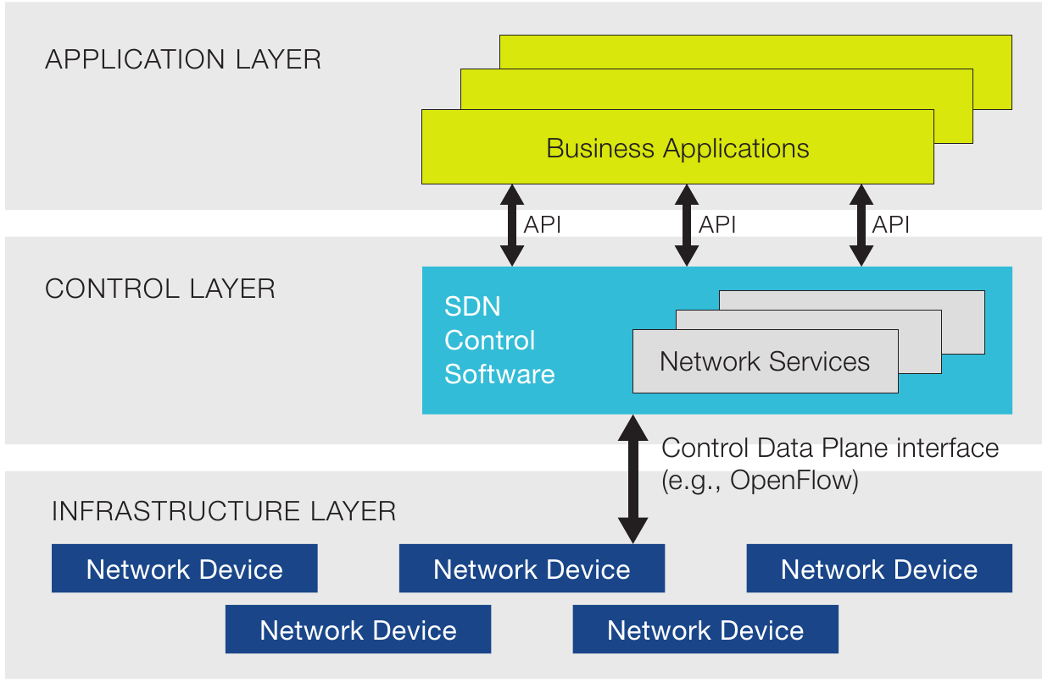
SDN

Slide 8
SDN Infrastructure

Slide 9
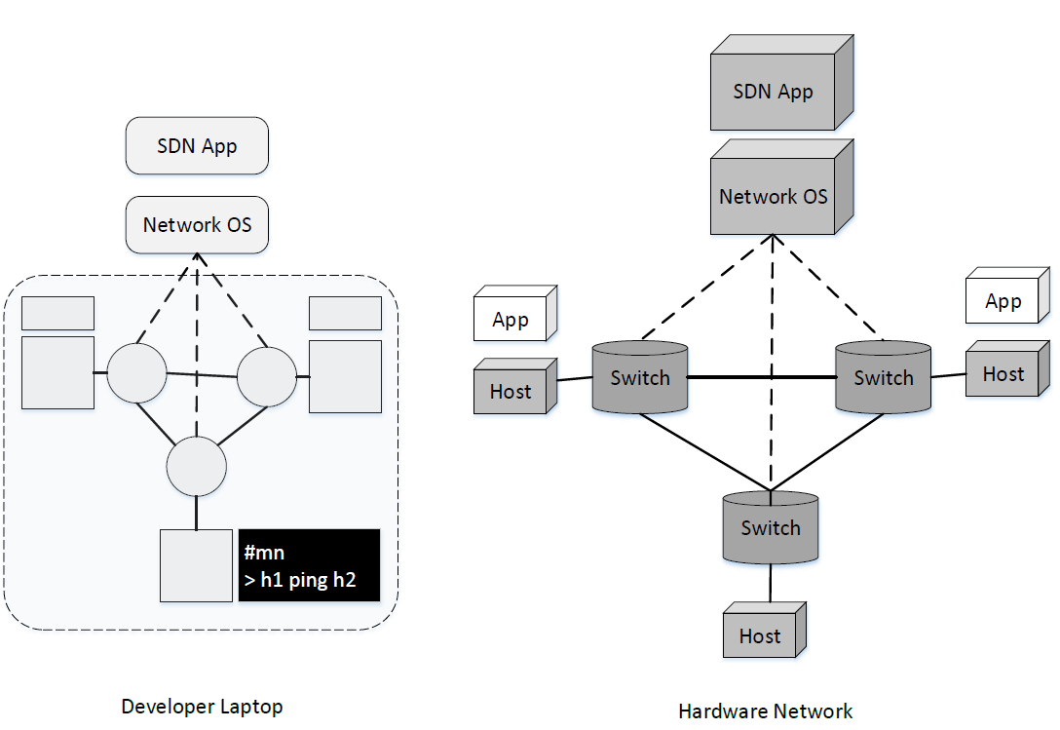
SDN Infrastructure: mininet

Slide 10
SDN Infrastructure: mininet
Lightweight realistic virtual network, running a real kernel, switch and application code, on a single VM with easy to use commands.
Mininet allows you to interact with your network through command line, share and deploy on real hardware.
It is primarily used for development, teaching and research.

Slide 11
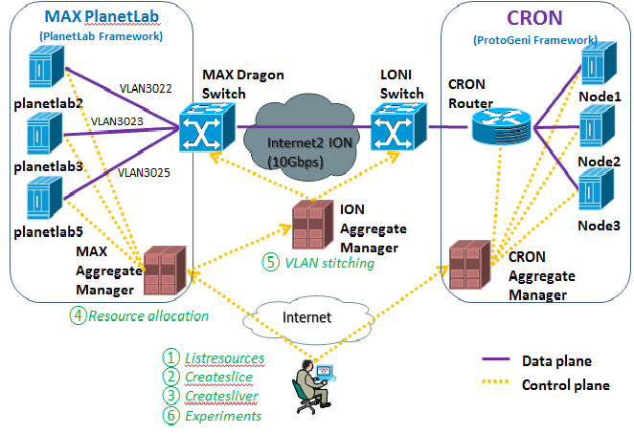
SDN Infrastructure: GENI

Slide 12
SDN Infrastructure: GENI
Distributed virtual laboratory for transformative at-scale experiments in network science, services and security.
The testbed is distributed across different campus around the globe.
The goal of the project is to bring deeply programmable environment to the network, similar to what cloud brought to the data-center.

Slide 13
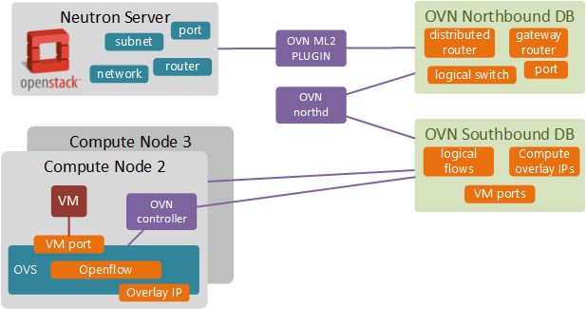
SDN Infrastructure: Openstack/devstack

Slide 14
SDN Infrastructure: Openstack/devstack
OpenStack is an opensource cloud platform. Openstack networking-odl is a library of drivers and plugins that integrates OpenStack Neutron API with Opendaylight backend.
The ML2 driver and L3 plugins present in the library allow communication between Openstack Neutron L2 and L3 resource API to OpenDaylight backend.

Slide 15
Mininet Installation
Using git source
$ g i t c l o n e g i t : / / g i t h u b . com/ m i n i n e t / m i n i n e t . g i t
$cd m i n i n e t
$ g i t t a g # l i s t a v a i l a b l e v e r s i o n s
$ g i t c h e c k o u t − b 2 . 2 . 1 2 . 2 . 1 # v e r s i o n
$ m i n i n e t / u t i l / i n s t a l l . sh [ o p t i o n s ]
$cd . .
Using Linux apt package.
$ sudo apt-get i n s t a l l m i n i n e t

Slide 16
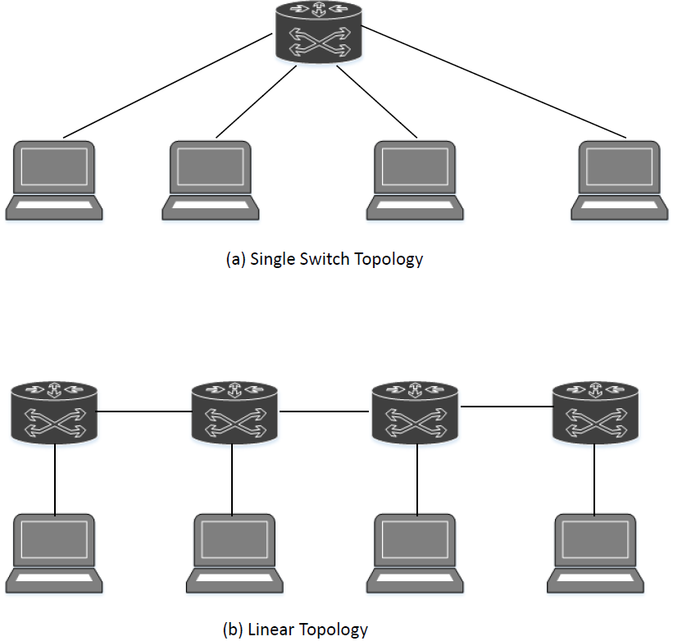
Flat and Linear Topologies

Slide 17
Flat and Linear Topologies Testing
$ sudo mn – test pingall –topo single,4
$ sudo mn – test pingall –topo linear,4
$ sudo mn -- link tc ,bw=10, delay=10ms
mininet> iperf

Slide 18
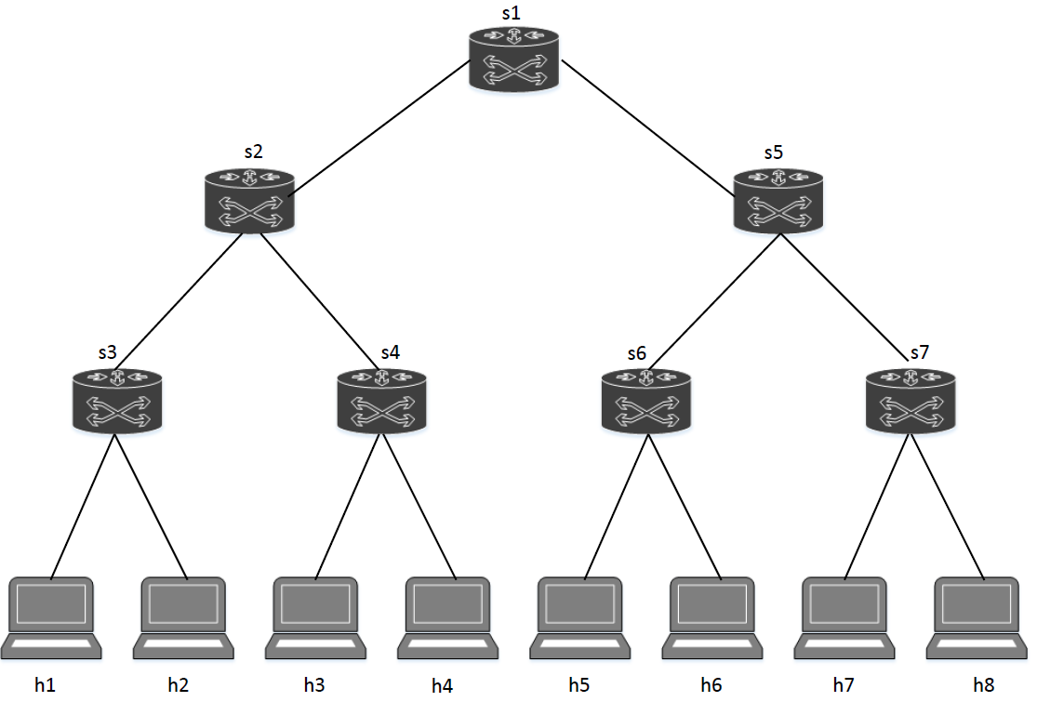
Tree Topology

Slide 19
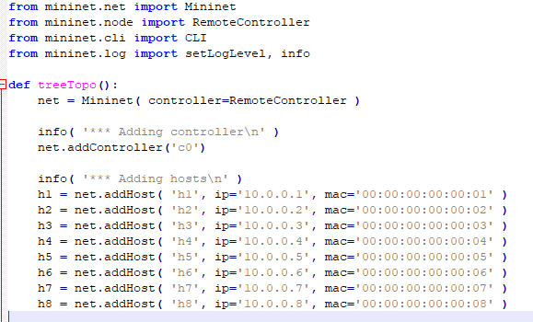
Tree Topology

Slide 20
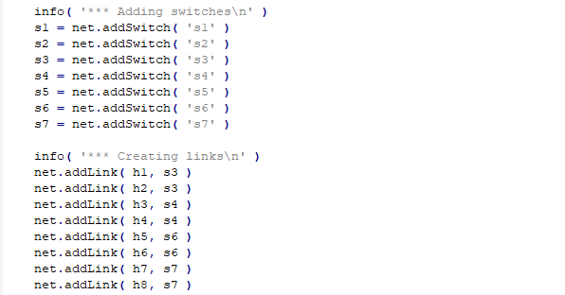
Tree Topology

Slide 21
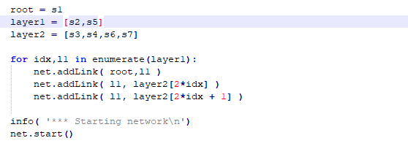
Tree Topology
$ sudo python tree.py

Slide 22
SDN Switch

Slide 23
Open vSwitch (OvS)
Open vSwitch (OVS) has become an integral part of SDN networks. It is one of the most popular OpenFlow switch.
It provides ability to replicate many features of a traditional switch, along with advanced features that allow the organizations to scale the cloud environment rapidly.

Slide 24
OvS Components
ovs-vsctl : Used for configuring the ovs-vswitchd configuration database (known as ovs-db).
ovs-ofctl : A command line tool for monitoring and administering OpenFlow switches.
ovs-dpctl : Used to administer Open vSwitch datapaths.
ovs−appctl : Used for querying and controlling Open vSwitch daemons.

Slide 25
ovs-vsctl
This tool is used for configuration and viewing OVS switch operations.
Port configuration, bridge additions/deletions, bonding, and VLAN tagging are just some of the options that are available with this command.

Slide 26
Open vSwitch (OvS)
#Terminal 1
$sudo mn --topo single , 4
#Terminal 2
$ sudo ovs-vsctl -V
ovs-vsctl (Open vSwitch ) 2.5.4
Compiled Oct 30 2017 10 : 38 : 01
DB Schema 7.12.1

Slide 27
ovs-vsctl
#Terminal 2
$ sudo ovs-vsctl show
898a8d3d-490d-44fa-beab-09a15a1294d8
Bridge "s1"
Controller "ptcp:6634"
fail_mode: standalone
Port "s1-eth1"
Interface "s1-eth1"

Slide 28
ovs-vsctl
#Terminal 2
$ sudo ovs-vsctl list-br
s1
$ sudo ovs-vsctl list-ports
s1-eth1
s1-eth2
$ sudo ovs-vsctl list interface

Slide 29
ovs-vsctl
#Terminal 2
# Creating a bridge in the switch database
$ sudo ovs-vsctl add-br s2
# Adding physical or virtual interface to the bridge$ $sudo ovs-vsctl add-port <bridge> <interface>

Slide 30
ovs-ofctl
#Terminal 2
#OpenFlow features and port description
$ sudo ovs-ofctl show s1
# Print the flow entries of a specified bridge.
$ sudo ovs-ofctl -O OpenFlow13 dump-flows s1

Slide 31
ovs-ofctl
#Terminal 2
#Print port statistics. This will show detailed information about interfaces
$ sudo ovs-ofctl dump-ports-desc s1
#Print description of the tables belonging to the bridge.
$ sudo ovs-ofctl dump-tables s1

Slide 32
ovs-ofctl
# Adding a static flow to the specified bridge.
$ ovs-ofctl add-flow <bridge> <flow>
# Deleting a flow from a specified bridge
$ ovs-ofctl del-flows <bridge> <flow>

Slide 33
ovs-appctl
# Dumping the OpenFlow flows including the hidden ones.
$ sudo ovs-appctl bridge/dump-flows s1
# Dumping datapath flows for only the specified bridge, regardless of the type.
$ ovs-appctl dpif/dump-flows <bridge>

Slide 34
ovs-appctl
# Lists the known logging modules and their current levels.
$ sudo ovs-appctl vlog/list

Slide 35
SDN Controllers

Slide 36
SDN Controllers
Controller | Description
NOX/POX | NOX is a C++ based SDN controller. NOX provides support for C++ Open- Flow APIs, fast asynchronous I/O. NOX can be easily deployed on variety of Linux platforms and includes many examples for basic SDN functions such as topology discovery, host tracking, etc. POX is a python variant of NOX, and has gained more popularity than NOX because it is easier to use.
Floodlight | An enterprise class Java based Open-Flow controller. It is supported by many industry partners such as Big Switch. The controller has been designed for high-performance multi-threaded applications, and can manage OpenFlow and non-OpenFlow networks.

Slide 37
SDN Controllers
Controller | Description
Opendaylight | A de-facto standard for service providers and enterprises making transition to SDN. It is one of the leading opensource platform for programmable SDN and has industry wide support.
ONOS | A distributed SDN controller running as a cluster of nodes which are identical in terms of their software stack. The controller can withstand the failure of individual nodes, without disruptions in the ability to control the network operations.
37

Slide 38
POX SDN
$ps -A | grep controller
$sudo killall controller
Download POX Code
$ git clone http://github.com/noxrepo/pox
$ cd pox

Slide 39
POX SDN
#Terminal 1
$./pox.py log.level --DEBUG misc.of_tutorial
#Terminal 2
$sudo mn --topo single,3 --mac --switch ovsk --controller remote

Slide 40
POX SDN
#Terminal 1
INFO:openflow.of_01:[Con 1/1] Connected to 00-00-00-00-00-01DEBUG:misc.of_tutorial:Controlling [00-00-00-00-00-01 1]
#Terminal 2
mininet> pingall
mininet> iperf

Slide 41
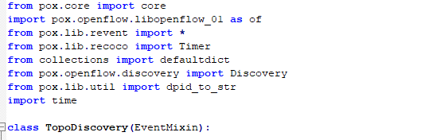
POX SDN Topo Discovery

Slide 42
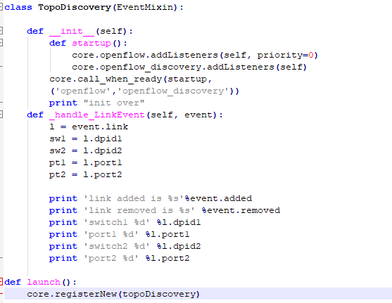
POX SDN Topo Discovery

Slide 43
POX SDN Topo Discovery
#Terminal 1
$./pox.py log.level --DEBUG misc.TopoDiscovery
INFO:openflow.
#Terminal 2
$sudo python tree.py
mininet> pingall

Slide 44
References
https://github.com/noxrepo/pox
http://mininet.org/
https://www.geni.net/
https://github.com/openstack/networking-odl/tree/master/devstack
https://www.opendaylight.org/
http://www.projectfloodlight.org/floodlight/

